Slide 1
Road Surface Estimation Project
By Tim Scott

Slide 2
Introduction

Slide 3
Project Description
Aim of Project
  Calculate Surface Area

Slide 4
Initial Research
Two Methods
  Image Processing
    From Satellites or other
  Calculated From databases
    Such as OpenMaps

Slide 5
Initial Research - Methodology
Research Different Approaches to the problem
Analyse the Pros and Cons of Each
Choose One to Proceed with

Slide 6
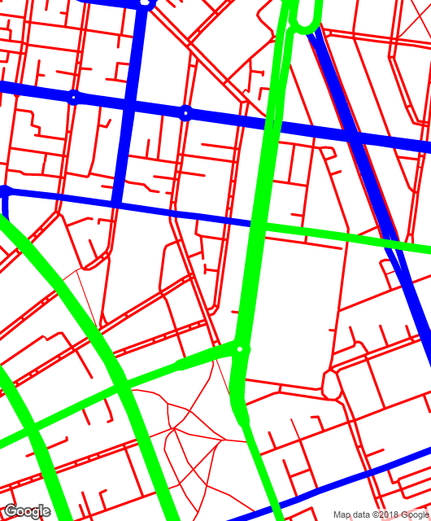
Initial Research – Image Processing
Pros
  Easy to access
  Intuitive method

Slide 7
Initial Research – Image Processing
Cons
  A lot of information can be lost depending on the picture
  If real satellite imagery trees, bridges and cars themselves can block the road
  If sanitised imagery, Like google terrain View Other roads and tunnels can block the road
  Requires you to save and analyse images
  Elevation difficult to deal with

Slide 8
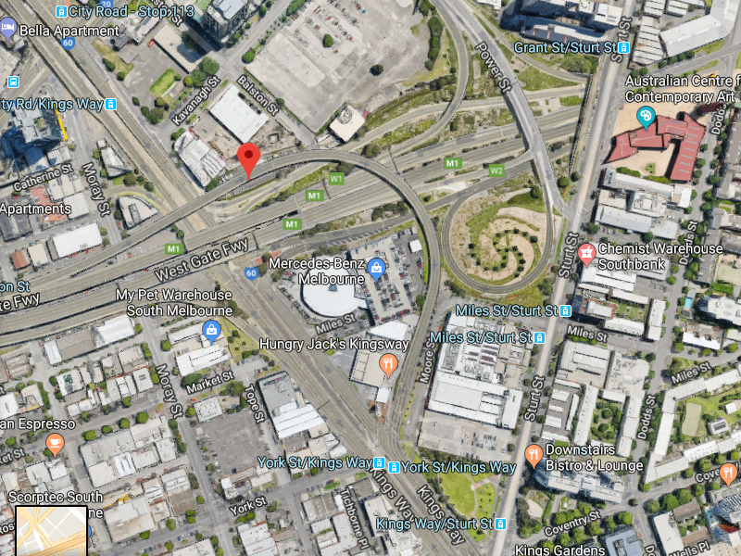

Slide 9
Initial Research - Database
Pros
  No image processing
  Contains more data than a single Image
  Can Deal with Bridges, roads ect with no issues

Slide 10
Initial Research - Database
Cons
  Harder to Visualize the area you are dealing with
  More Work needed to get all the roads through a certain area.

Slide 11
Initial Research- Road bumps
How to deal with Shoulders, Native Strips, Pathways
Elevation

Slide 12
Decision
Image Processing

Slide 13
My Project

Slide 14
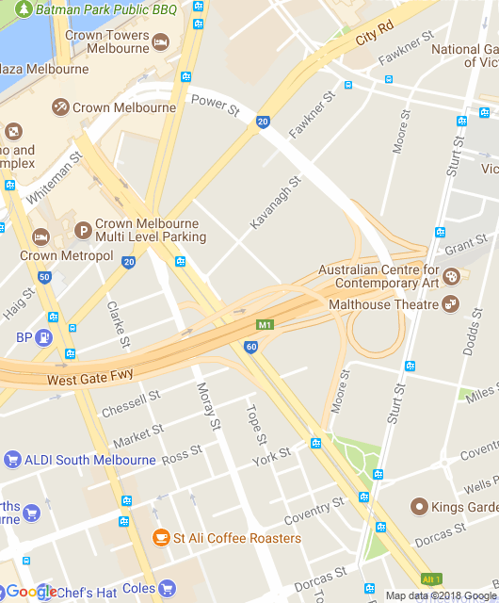
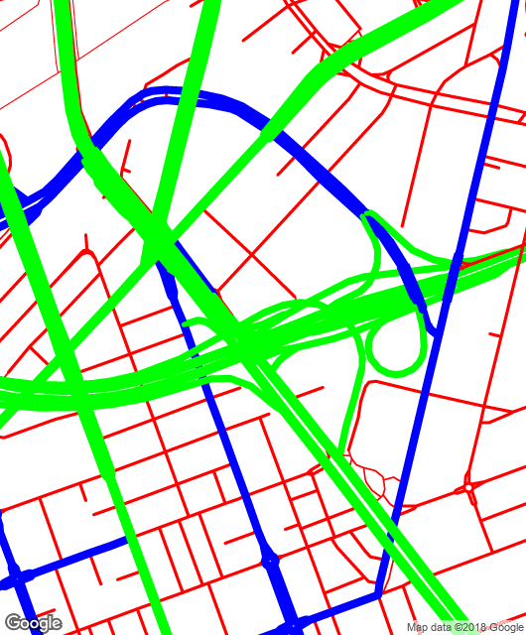
The Image

Slide 15
References
[1] G. Máttyus, W. Luo and R. Urtasun, "DeepRoadMapper: Extracting Road Topology from Aerial Images," 2017 IEEE International Conference on Computer Vision (ICCV), Venice, 2017, pp. 3458-3466.
[Accessed 12 Apr. 2018].
[2] Google Developers. (2018). Overview | Google Maps Embed API | Google Developers. [online] Available at: https://developers.google.com/maps/documentation/embed/guide [Accessed 12 Apr. 2018].
[3] “Road Resurfacing Newsletter.” Brisbane City Council, [Accessed 13 Apr. 2018]
[4] Paplinski, A. (2018). FIT3036 - 3rd Year Project. [ebook] Monash University. Available at: https://moodle.vle.monash.edu/pluginfile.php/6786013/mod_resource/content/5/Project%20Intro.pdf [Accessed 12 Apr. 2018].
[5] “Engineering Road Note 1.” Government of Western Australia, [Accessed 12 Apr. 2018]

